Slide 1
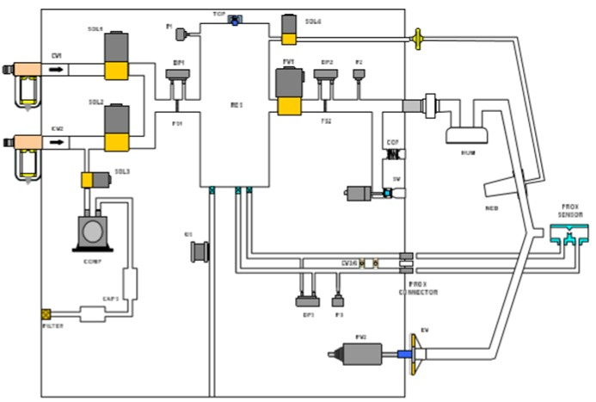
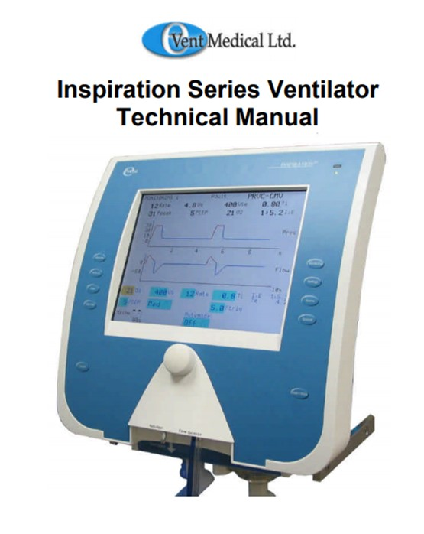
2003 eVent advanced ventilator
Reproduced from a published document; but without express permission.
Safety relief
FR
FR
FR
Compressor for
transport or supply fail ventilation
The 2003 eVent Inspiration was a low cost concept that incorporates all modes of pressure and volume control ventilation. Its pneumatic diagram is on page 17 of its published service manual:
http://www.frankshospitalworkshop.com/equipment/documents/ventilators/service_manuals/eVent_Medical_Inspiration_Ventilator_-_Service_manual.pdf
Voice coil actuator
0.02L/min flow past oxygen cell.
0.02L/min flow to keep water droplets and patient cough secretion out of the pressure measurement lines.

Slide 2
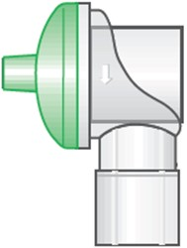
Equivalent blender design
Mixing chamber must not exceed the pressure-volume threshold for becoming classed as a pressure vessel. Such vessels can store a lot of energy and therefore have strict, complicated safety regulations.
Remember, the breathing circuit inspiratory tube tends to have a volume of about 1.5L, in which gas flows faster in the centre of the tube and slower on the wall. Mixing will therefore continue throughout the 1.5L tube towards the patient.
Differs from the eVent Inspiration in being continuous and not pressure cycled.
Safety shutdown
(monitor)
Pop-off safety relief
(1.5bar)
Blender control
SV1
SV3
PR1
Ptr1
Ptr2
Ptr3
500ml
Mixing
Chamber
(max 1 bar)
Air
2.5 to 5bar
NC
Gas Output
Flow rate 60 L/min
4mbar to 35mbar
22mm conical connector, Male
NC
NR1
Ptr4
NR3 22mm
PR2
SV2
SV4
Pressure monitor
Oxygen
2.5 to 5bar
NC
FR1
EV1
NC
NR2
Gas Return
FR2
NR1, 2 guards against reverse flow into the hospital supply lines.
Oxygen cell
NR4 22mm
By further making SV3 and SV4 proportional, and adding a proximal flow sensor, the design is effectively similar to an eVent Inspiration and can perform all advanced Volume Controlled modes of ventilation
Exhaust
Exhaust

Slide 3
Blending cycle
Sum of ADC values
Reset cycle
Flow sensor counts through a pre-determined number of air units, followed by a number of oxygen units. The number of units corresponds to a volume. Because PR1 and PR2 are set to the same pressure, there is no need to linearize and convert the volume units into a SI unit.
The blend is determined by the proportional switch point between the two gas units. The pre-determined unit count thresholds are set, in software, so that the blender cycles approximately once every breath (about every 4 seconds).
Remember, oxygen is 3% denser than air, and FiO2 is a volume/volume measure. PTR1 is a mass-flow sensor. The oxygen unit might need to be increased by 3% for volumetric proportioning. Test and see if a small correction factor is needed. The international standard set a tolerance of 3%.
The pressure in the mixing chamber equals the input regulators PR1 and PR2. It must be 1bar or less – or else pressure vessel controls become necessary in many parts of the world. This calls for SV3 having a larger orifice, to secure the flow rate.
Oxygen intake
Switch gas
Air intake
0
time
Say, PTR1 is sampled at 10-bit (0 to 1024) every 2mS, and the PTR1 flow orifice creates an ADC integer value of 800 when flow is 60L/min. Each ADC value of 800 represents a volume of 2ml.
Over a full 500ml, 3s breath cycle, the average ADC value is 133 (because there is no flow from ventilator during the inspiration plateau and exhalation phase). 1500 samples over 3s add up to a long integer value of 200,000. This should be the blender cycle reset point.
The variable switch value between 0 and 200,000 creates an oxygen concentration. In the above graph, the switch point is set to 100,000, producing a mix of 50% by volume of oxygen and 50% by volume of air. The resulting FiO2 = (50% x 100% O2) + (50% x 21% O2) = 60.5%.

Slide 4
Pseudo code for blender control
// Declared constants
MAX_VALUE = 200000
- - - - - - - - - - - - - - - - - - - - - - - - - - - - - - - - - - - -
// User interface
IF
FiO2 value is changed // An integer value between 21 and 100
SWITCH_VALUE = (-2533 * FiO2) + 253300
ENDIF
- - - - - - - - - - - - - - - - - - - - - - - - - - - - - - - - - - - -
// Routine called every 2mS
Read ADC for FLOW_VALUE // PTR1
VOLUME = VOLUME + FLOW_VALUE
IF VOLUME > MAX_VALUE
Close SV2 // Oxygen valve
Open SV1 // Air valve
VOLUME is zero // Reset cycle
ELSE
IF VOLUME >= SWITCH_VALUE
Open SV2 // Oxygen valve
Close SV1 // Air valve
ENDIF
ENDIF
VOLUME
MAX_VALUE
Oxygen intake
SWITCH_VALUE
Air intake
0
time

